Slide 1
Karnaugh Maps
CSE 4205: Digital Logic Design
Aashnan Rahman
Junior Lecturer
Department of Computer Science and Engineering (CSE)
Islamic University of Technology

Slide 2
01
Karnaugh Maps
Boolean simplification made easy

Slide 3
Karnaugh Maps
Karnaugh maps (K-maps) are a visual method used in digital logic design to simplify Boolean algebra expressions.
They help reduce logic circuits by minimizing the number of terms and variables.

Slide 4
A few things before we proceed

Slide 5
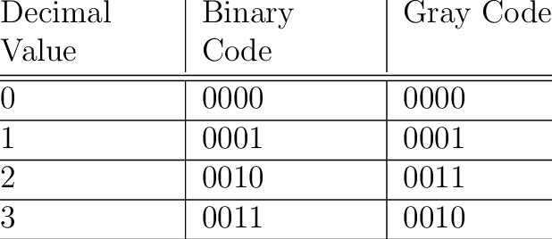
Gray Code
Gray code is a binary coding system where consecutive values differ by only one bit. This property minimizes errors when transitioning between values.

Slide 6

Truth Tables
A | B | C | F
0 | 0 | 0 | 0
0 | 0 | 1 | 0
0 | 1 | 0 | 1
0 | 1 | 1 | 0
1 | 0 | 0 | 1
1 | 0 | 1 | 1
1 | 1 | 0 | 1
1 | 1 | 1 | 1
We won’t be drawing truth tables anymore, rather we will be only mentioning minterms/maxterms.

Slide 7
Karnaugh Maps
Boolean expression can be simplified by Boolean algebra using cut and try method, but it’s manual and there are no specific rules.
K-map is a simple and straightforward way to minimize boolean function.
Can be regarded as pictorial form of a truth table.

Slide 8
Karnaugh Maps
Made up of squares, each square represents a minterm.
2. Pictorial representation of all possible ways a function may be expressed in
standard form.

Slide 9
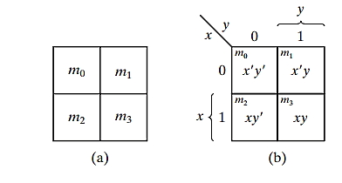
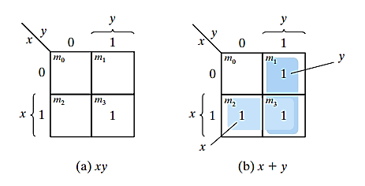
2 variable K-maps
Two variables – Four minterms
Four Squares in K-map
Minterm corresponding to a square can be obtained from the concatenation of the row and column number
Note: A square is marked with 1, if that minterm asserts the function

Slide 10
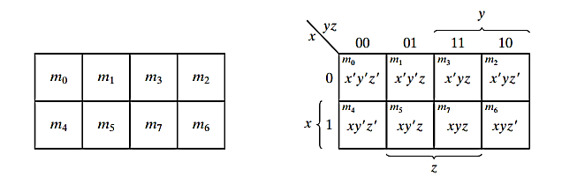
3 variable K-maps
Three variables – Eight minterms
Eight Squares in K-map
Minterms are expressed symbolically in binary equivalent sequence
but arranged in k-map as a sequence of reflected code
Only one-bit changes in value from one adjacent column to the next
Any two adjacent squares in the map differ by only one variable

Slide 11
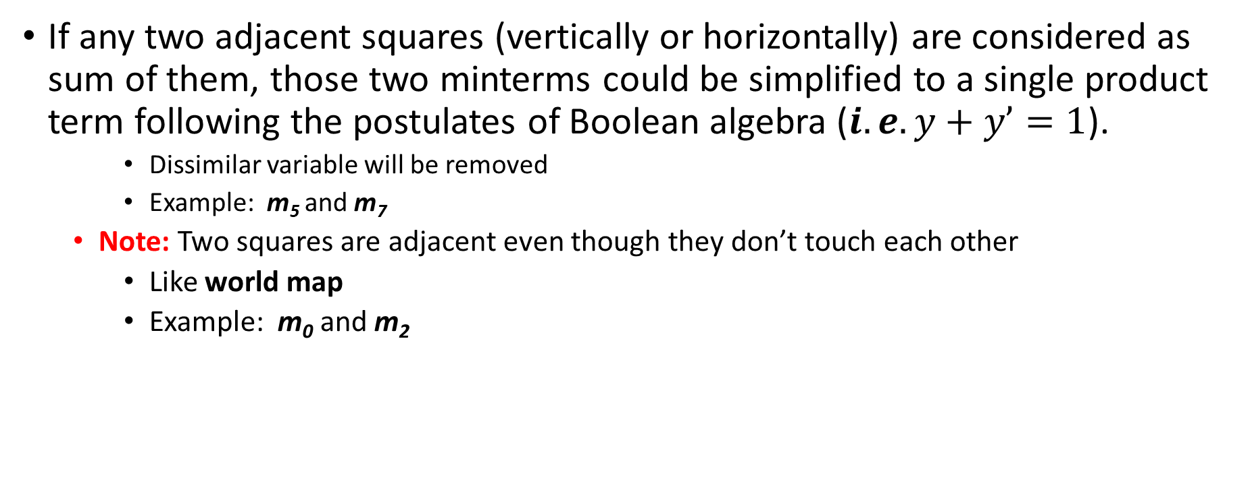
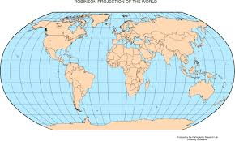
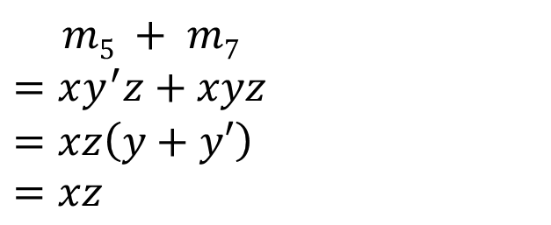
3 variable K-maps

Slide 12
4 variable K-maps
Four variables – Sixteen minterms
Sixteen squares in K-map
Both columns and rows are numbered in Gray code sequence
Only one variable change in any two adjacent squares row-wise or column-wise.
The map is considered on the surface whose top and bottom edges and right and left edges are attached to each other to form adjacent squares
Only one-bit changes in value from one adjacent column to the next
Any two adjacent squares in the map differ by only one variable

Slide 13
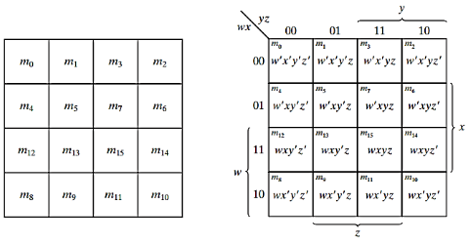
4 variable K-maps

Slide 14
Definitions
Implicants
A group of adjacent squares in K-map consisting of 2^{n} 1s representing true minterms in the function.
Prime Implicants
A product term/implicant obtained by combining the maximum possible number of adjacent squares in the map.
Essential Prime Implicants
Prime implicant that has at least one minterm which is not covered by any other prime implicants. This prime implicant must be included in the simplified expression.

Slide 15
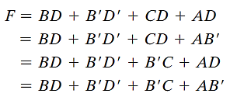
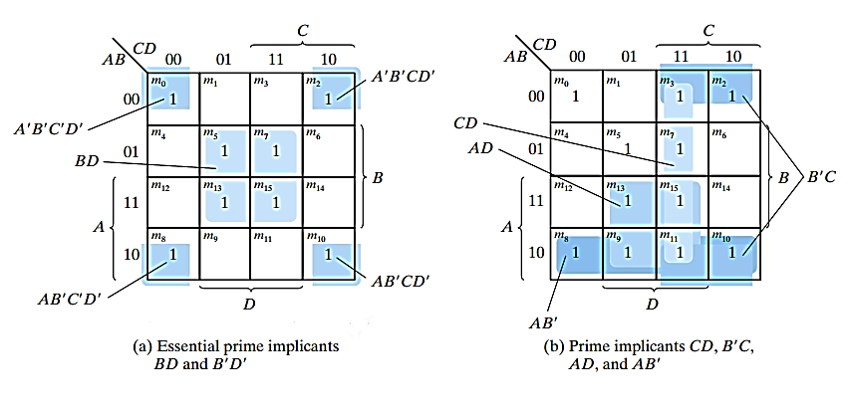


1. The essential prime implicants are the
only ways to cover some minterms
2. There are more alternatives of prime
implicants to cover remaining minterms

Slide 16
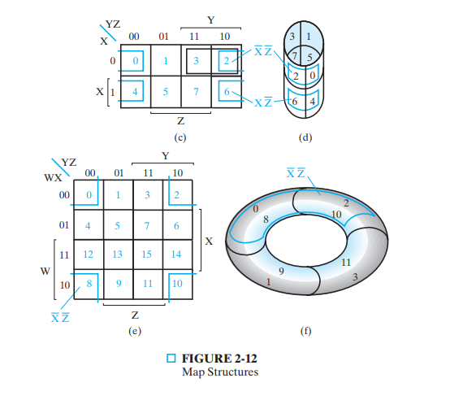

Slide 17
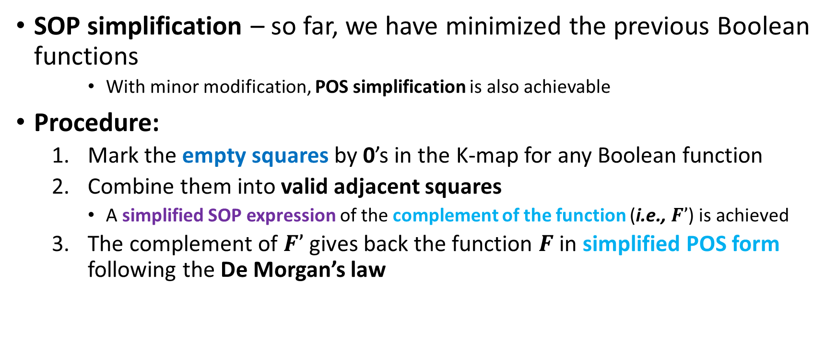
Simplification

Slide 18

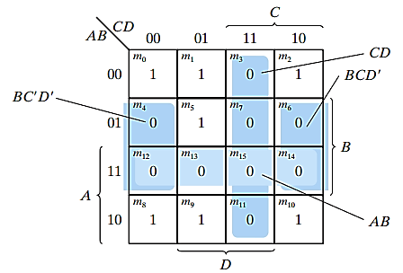
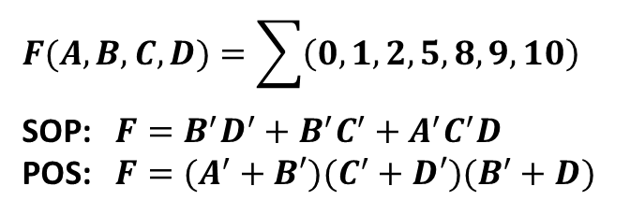
Simplification

Slide 19
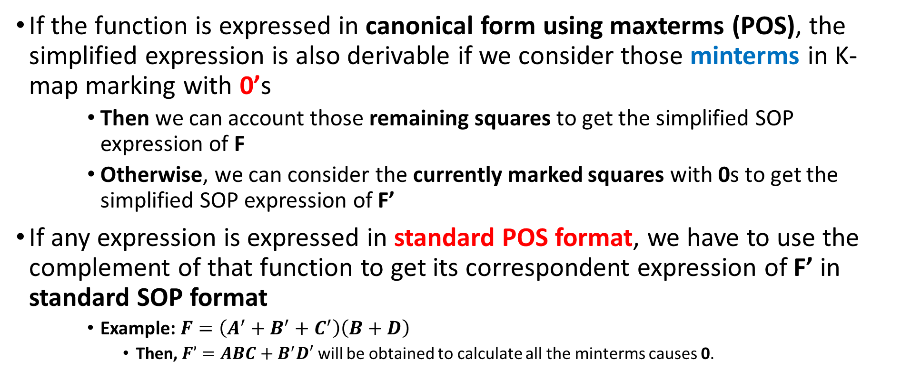
Simplification

Slide 20
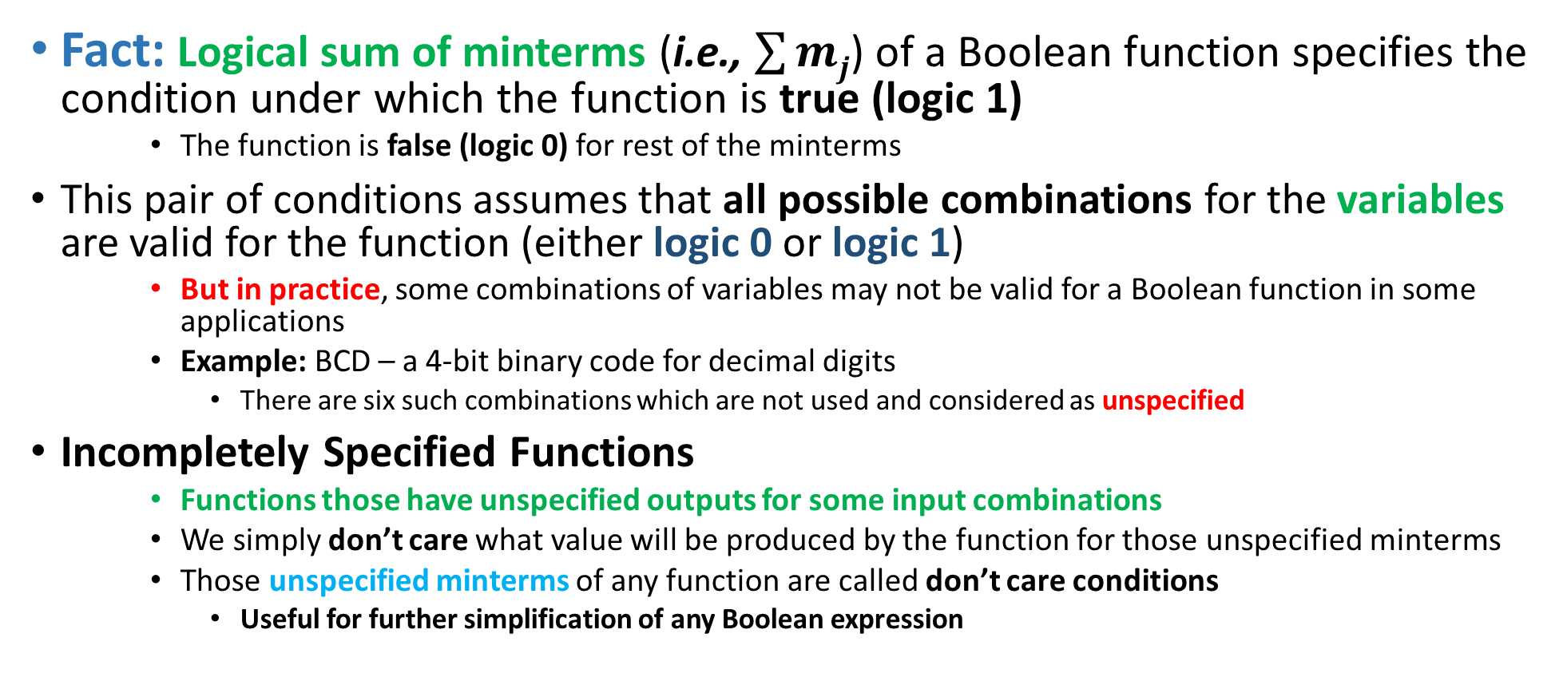
Simplifications with Don’t Care

Slide 21
Simplifications with Don’t Care
A don’t care minterm is a combination of variables whose logical value (0 or 1) is not specified (i.e., defined) in the Boolean function
    So that corresponding square can’t be marked with 1 or 0 in the K-map
    Rather “X” could be placed in that corresponding square distinguishing from 0 and 1
    It indicates that we don’t care whether the value of 0 or 1 is assigned to that function for that minterm
For better simplification, adjacent don’t care square may be assumed to be either 0 or 1
    Preference of 0 or 1 depends on which combination gives the simplest expression
Trick: To get the simplified expression of any Boolean function, we must include all 1s, but we may or may not include any of the Xs based on preference
    Initially, those don’t care minterms could be unspecified, but when a particular choice is made, they should be treated differently.

Slide 22
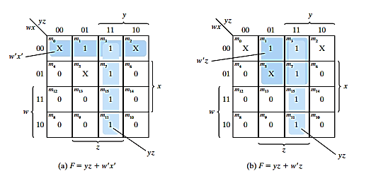
Simplifications with Don’t Care

Slide 23
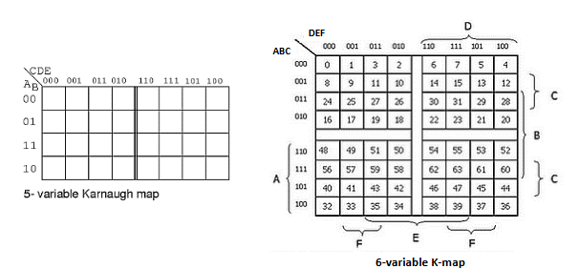
5/6 variable K-maps

Slide 24
5 variable K-map
A’
A
DE
DE
BC
BC

Slide 25
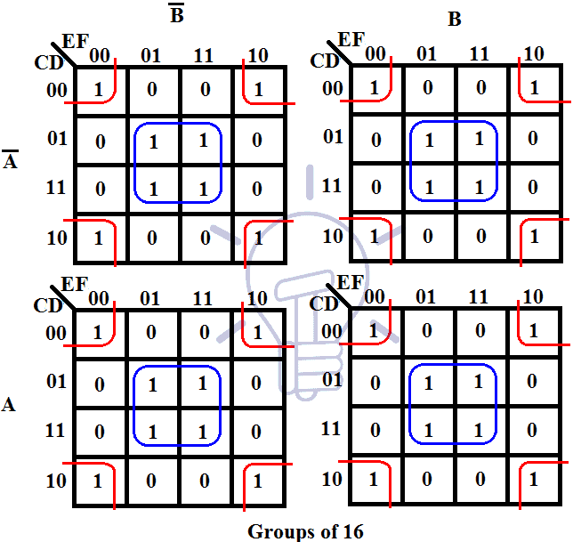
6 variable K-map

Slide 26
Tool
Resources
K-map solver
GeekforGeeks
UMD
Worksheet

Slide 27
Thank You !!
Feel free to ask any questions

